Slide 1

Student Fine Management System
BCA C Programming Project
Presented by:
Aastha G.C.
Shital Thapa

Slide 2
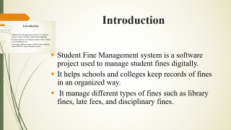
Introduction
Student Fine Management system is a software project used to manage student fines digitally.
It helps schools and colleges keep records of fines in an organized way.
It manage different types of fines such as library fines, late fees, and disciplinary fines.

Slide 3

Why We chose this project?
Saves Time
Avoids mistakes
Easy to use
Keeps records safe
Reduces paperwork
Helpful for schools and colleges

Slide 4
Objectives
To manage student fines easily
To reduce manual paperwork
To save time in fine management
To make searching records faster
To improve management efficiency
To avoid calculation mistakes

Slide 5
Conclusion
The student Fine management system helps schools and colleges manage student fines in an easy, fast, and accurate way. It also helps avoid calculations errors and saves valuable time. Overall, this project improves the efficiency, transparency, and reliability of fine management in educational institutions.

